Slide 1
Agri- Helper (a organized resource about Crops,farm products)
TEAM MEMBERS:
Kishore S
Krishna S
Venkatesh M

Slide 2
Problem Statement
The agriculture sector in India remains the backbone of its society, employing ~58% of the population. Farmers may lack the necessary knowledge and guidance on the proper application and safe use of pesticides and fertilizers.
Illiteracy leading to farmers using outdated methods of cultivation. There are very few platforms where people can discuss agriculture-related issues, share ideas, and exchange knowledge.
So we are developing a platform where plenty of up-to-date information available to farmers , helping them optimize production and increase profitability

Slide 3
Objectives
To provide all details about Pesticides and Fertilizers for your crop at One place
To Provide useful tips and tricks for growing and harvesting crops.
To provide latest News about trends in Agriculture sector and government policies and Crop diseases and control
To encourage farmers with success stories of farmers who have implemented innovative methods.
To make aware of various constraints and management strategies for better crop production

Slide 4
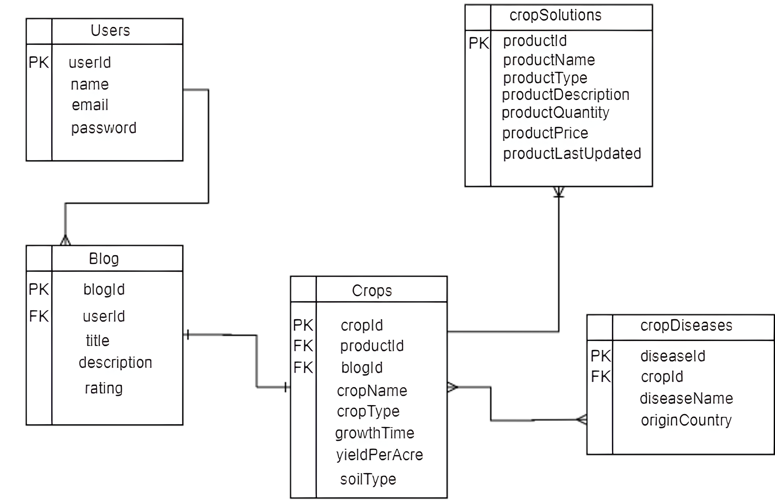
ER Diagram

Slide 5
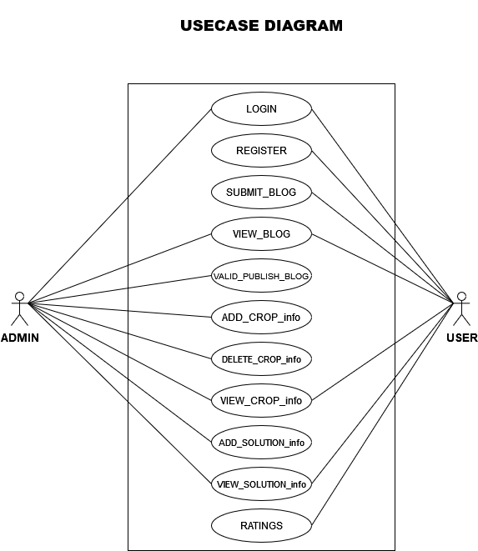

Slide 6
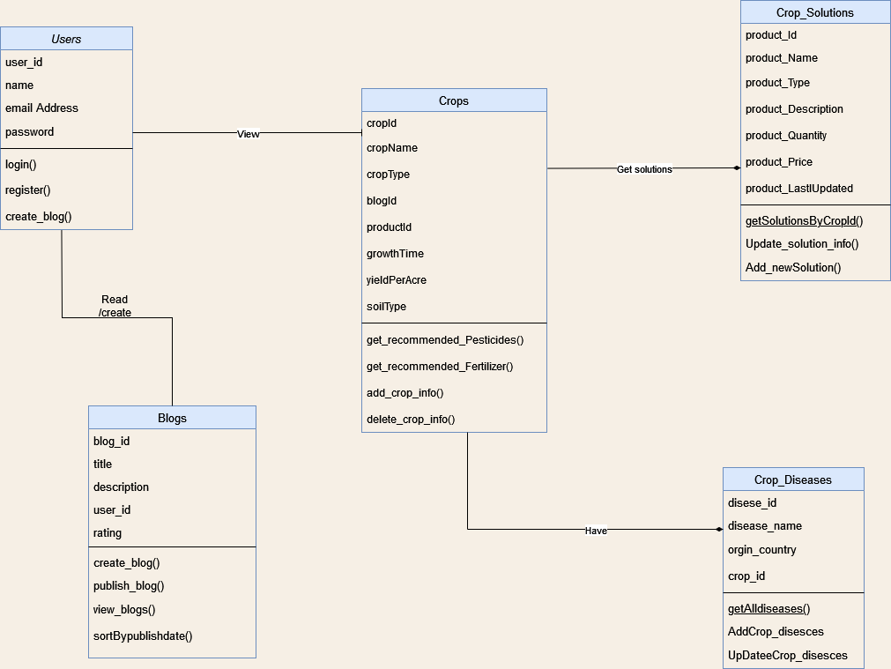
Class Diagram

Slide 7
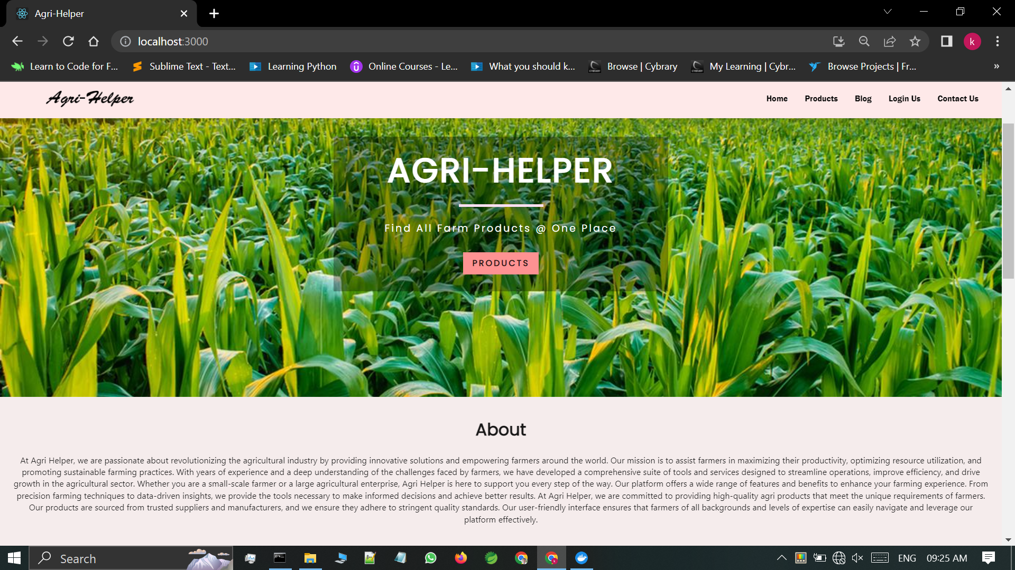
output screenshots

Slide 8
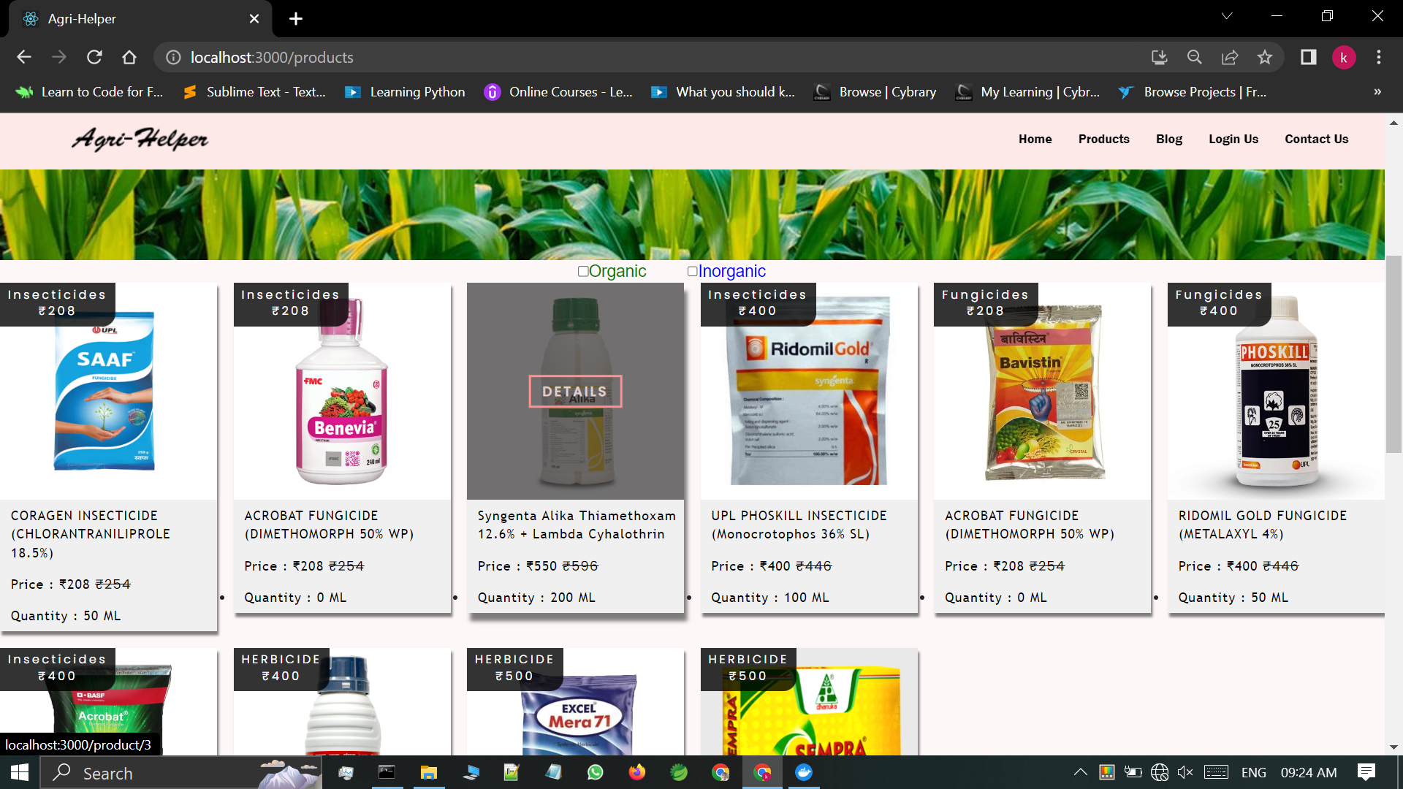

Slide 9
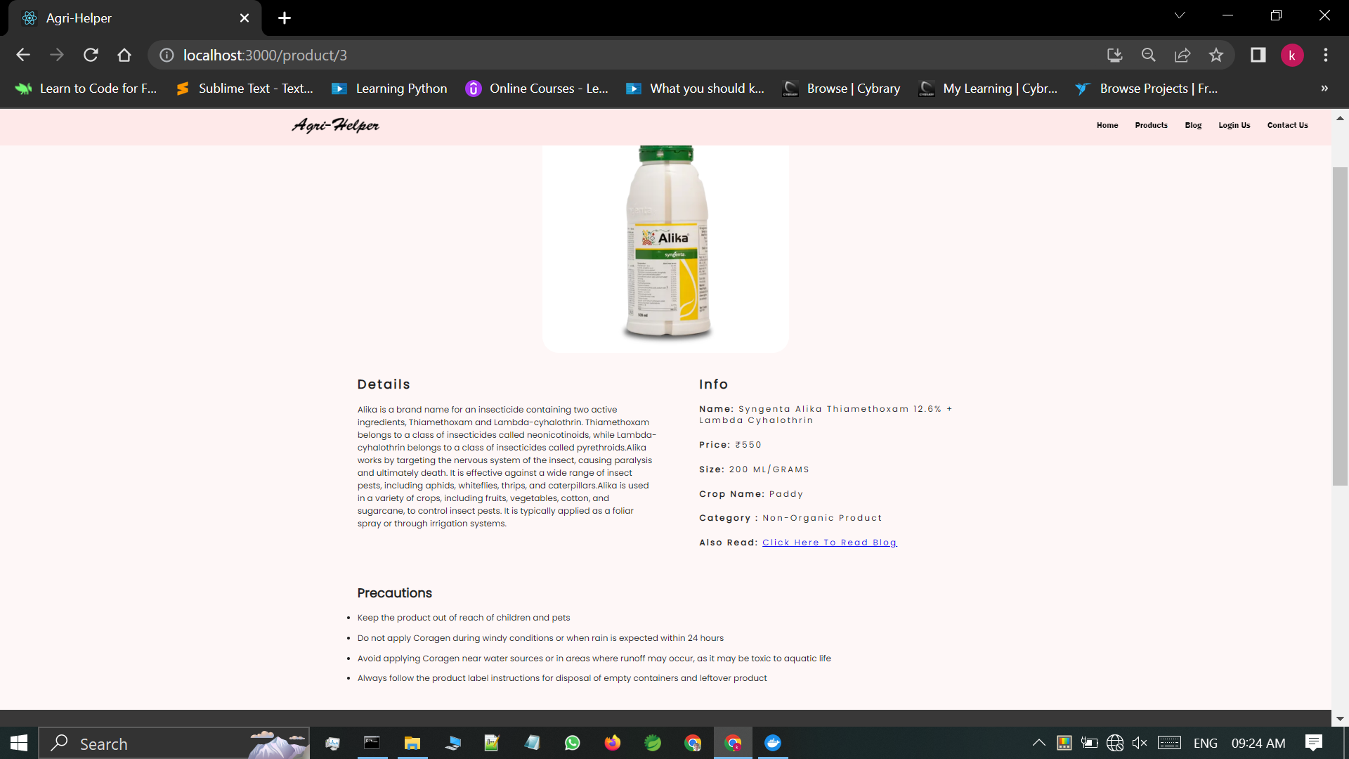

Slide 10
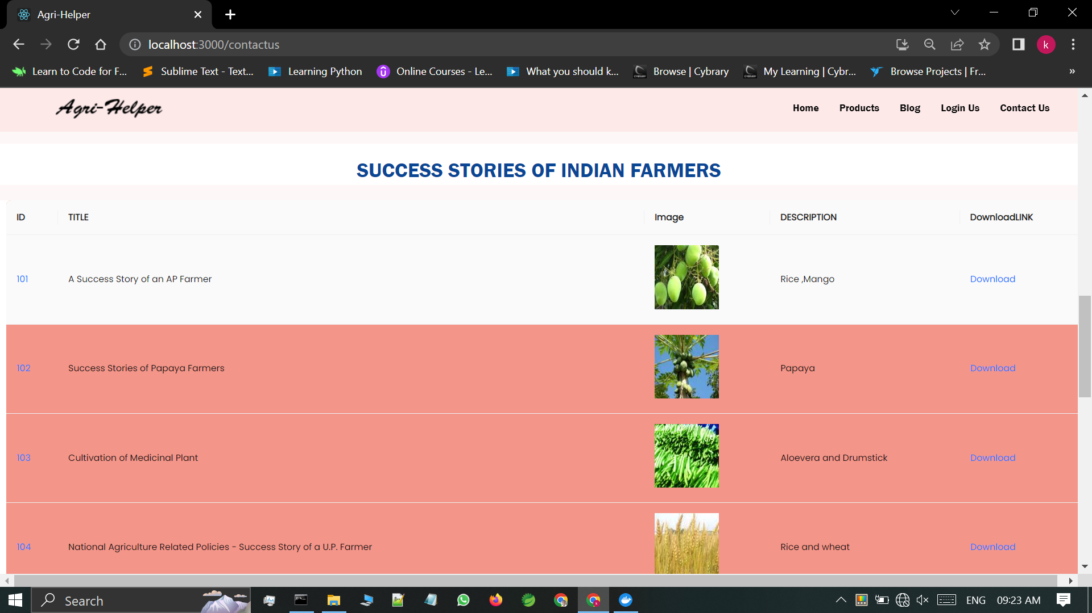

Slide 11
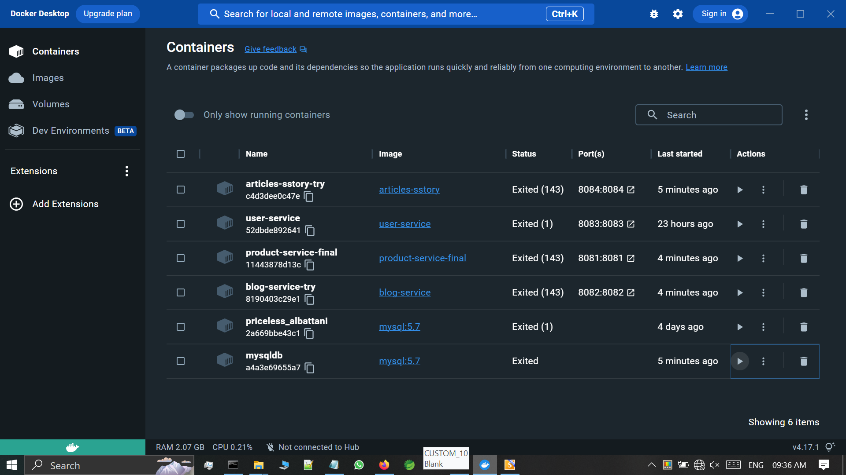

Slide 12
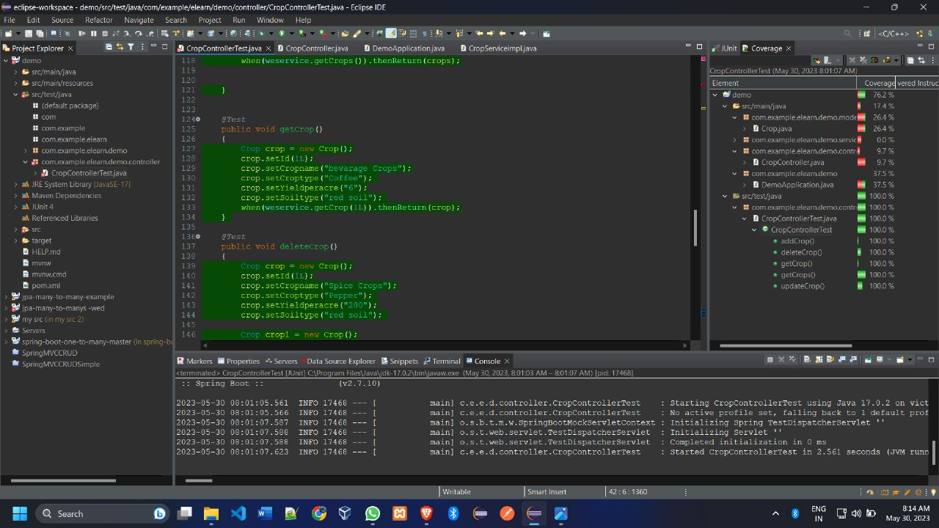
Test Cases sample screenshot

Slide 13
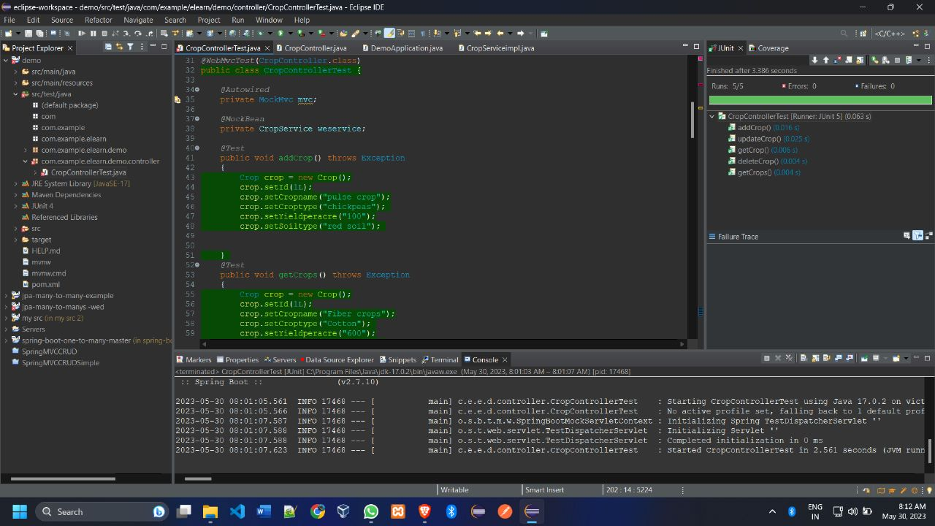

Slide 14
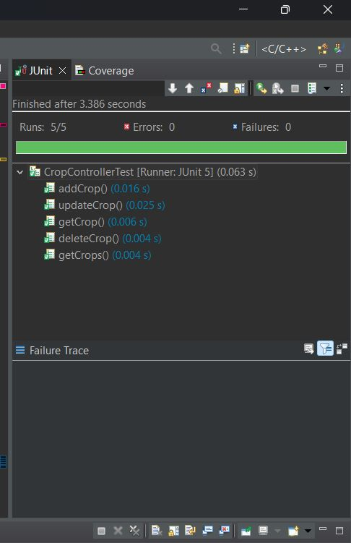
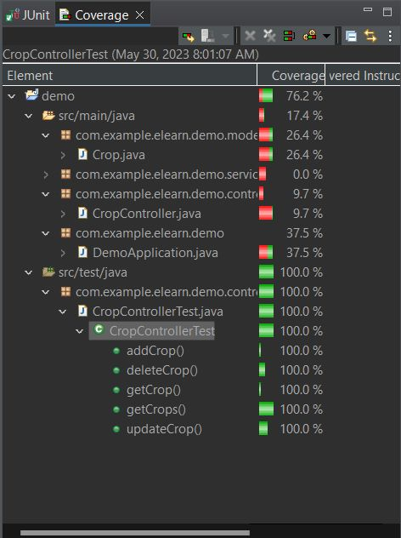

Slide 15
Future Enhancements:
Weather data and reports
Market price of agri products
Spring boot to Flask server communication to get data about plant disease
Users dashboard

